Slide 1

DATA STRUCTURES AND ALGORITHMS (113215)
Dr. Owais Hussain

Slide 2

Agenda
Sorting
Sorting algorithms
Bubble sort
Selection sort
Insertion sort

Slide 3
Sample 2
Sorting
Sorting operation organizes data in ascending or descending order.
One of the most vital usages of sorting is searching for data. Database systems create special columns called indexes which keep references of each record in sorted manner. This helps in improving the search significantly.
E.g., if you wanted to find lowest and highest GPA in your class, then:
In unsorted array, you will have to traverse entire array.
In a sorted array, you will only read value at first and last positions.

Slide 4
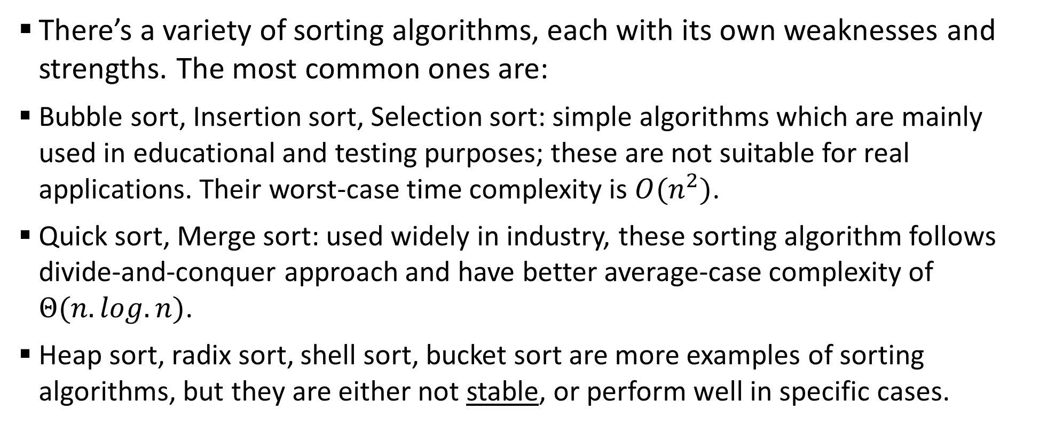
Sample 2
Sorting Algorithms
There’s a variety of sorting algorithms, each with its own weaknesses and strengths. The most common ones are:
Bubble sort, Insertion sort, Selection sort: simple algorithms which are mainly used in educational and testing purposes; these are not suitable for real applications. Their worst-case time complexity is $O(n^{2})$.
Quick sort, Merge sort: used widely in industry, these sorting algorithm follows divide-and-conquer approach and have better average-case complexity of $Θ(n.log.n)$.
Heap sort, radix sort, shell sort, bucket sort are more examples of sorting algorithms, but they are either not stable, or perform well in specific cases.
Notes:
In context of algorithms, the term stable means that the elements retain their original position. For example, a stable algorithm will sort the following:
{A, b, c, B, d, a, e} to {A, a, b, B, c, d, e} while an unstable algorithm might do: {a, A, b, B, c, d, e}

Slide 5
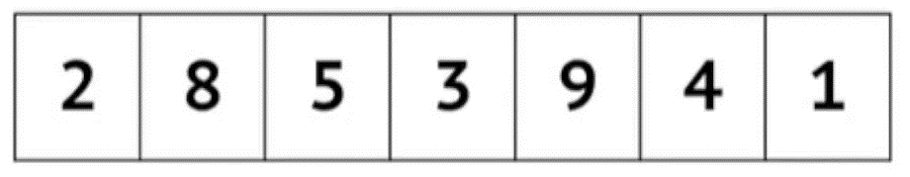
Sample 2
Bubble Sort
Bubble sort traverses the array, visits each element and matches it with its next neighbour. If the order is incorrect then the elements are swapped.
This way, in each iteration a sorted partition is formed on the right side and unsorted elements remain on the left side.
The following animation simulates how an array is sorted using Bubble sort algorithm.
Notes:
Animation credit: Michael Sambol

Slide 6
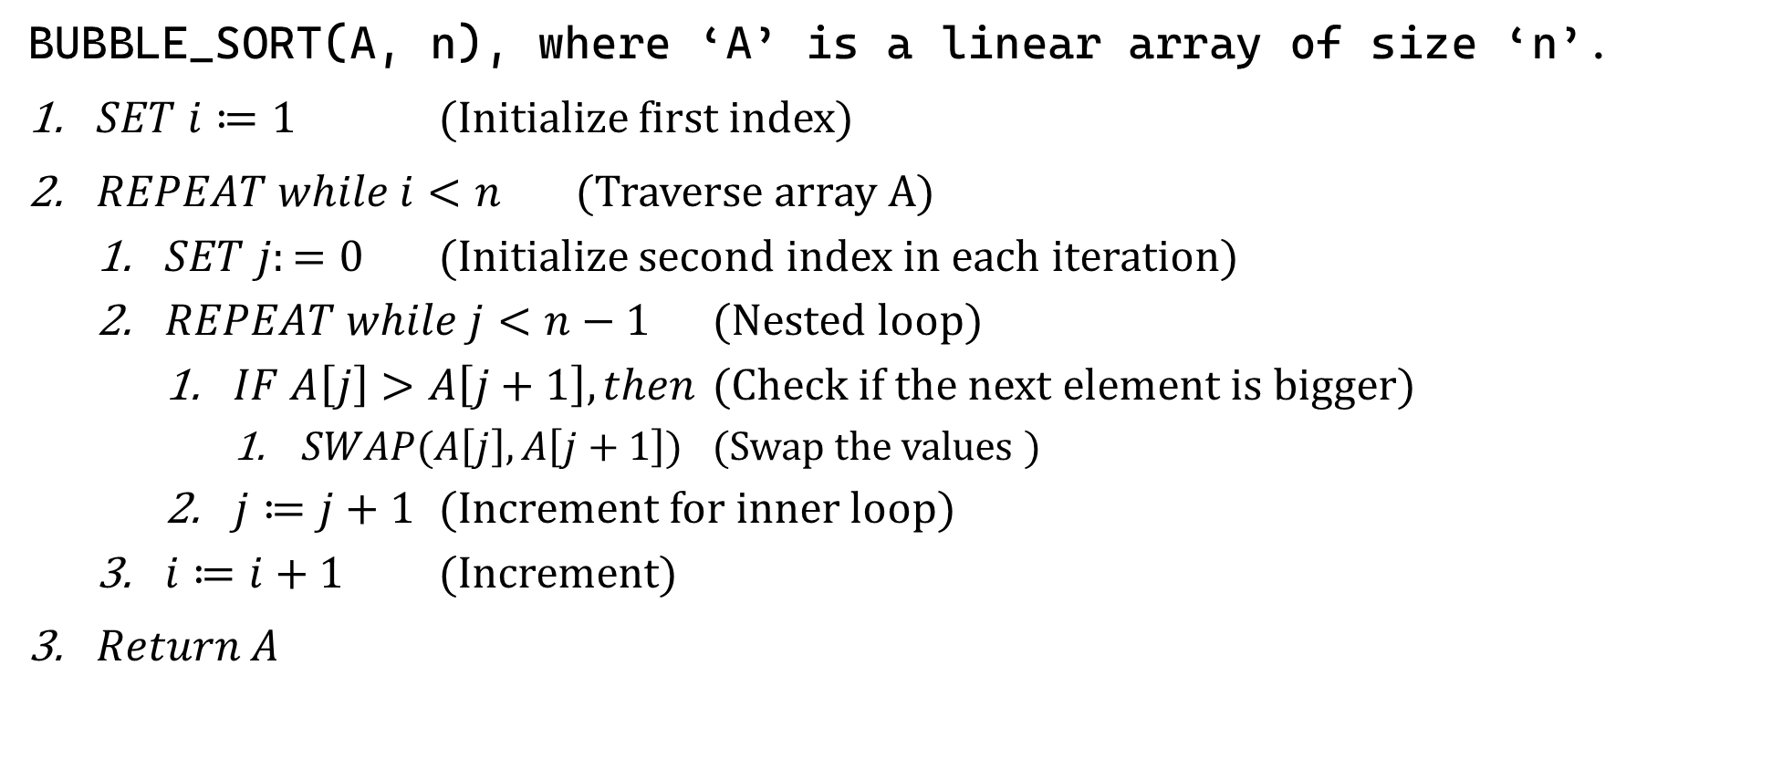
Sample 2
Bubble Sort
BUBBLE_SORT(A, n), where ‘A’ is a linear array of size ‘n’.
$SET i≔1$ (Initialize first index)
$REPEAT while i<n$ (Traverse array A)
$SET j:=0$ (Initialize second index in each iteration)
$REPEAT while j<n−1$ (Nested loop)
$IF A\left[j\right]>A\left[j+1\right], then$ (Check if the next element is bigger)
$SWAP(A\left[j\right], A\left[j+1\right])$ (Swap the values )
$j≔j+1$ (Increment for inner loop)
$i≔i+1$ (Increment)
$Return A$

Slide 7
Sample 2
Exercise
Create groups of 5 students each.
Create an unsorted array with your current GPAs.
Following the Bubble sort algorithm, show how your array will be sorted step-by-step.
Assuming each statement took 3ms to run, calculate the total time it took for your array to be finally sorted.

Slide 8
Sample 2
Bubble Sort Optimization
Optimizing step in Bubble sort.
In the first pass, check if the array is already sorted.
Match each element with the next one. If every next element is either same or higher, then the array is sorted.
Second optimization could be to run the inner loop each time for 1 less iteration than previous.

Slide 9
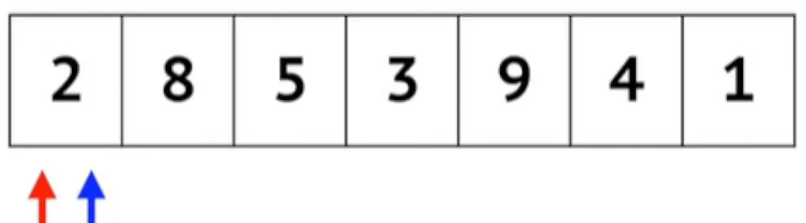
Sample 2
Selection Sort
Selection sort traverses the array iteratively. In each iteration, the smallest unsorted value is moved to its respective place.
This way, in each iteration a sorted partition is formed on the left side and unsorted elements remain on the right side.
The simulation shows how an array is sorted using Selection sort algorithm. Blue arrow is for current “element” and red represents current “lowest”.
Notes:
Animation credit: Michael Sambol

Slide 10
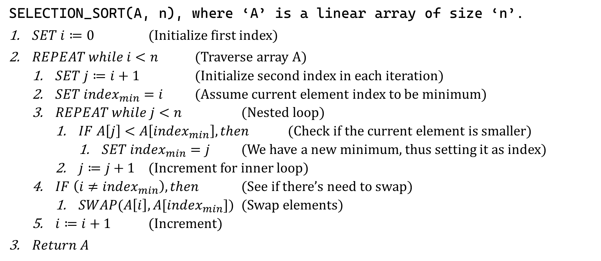
Sample 2
Selection Sort
SELECTION_SORT(A, n), where ‘A’ is a linear array of size ‘n’.
$SET i≔0$ (Initialize first index)
$REPEAT while i<n$ (Traverse array A)
$SET j≔i+1$ (Initialize second index in each iteration)
$SET index_{min}=i$ (Assume current element index to be minimum)
$REPEAT while j<n$ (Nested loop)
$IF A\left[j\right]<A\left[index_{min}\right], then$ (Check if the current element is smaller)
$SET index_{min}=j$ (We have a new minimum, thus setting it as index)
$j≔j+1$ (Increment for inner loop)
$IF \left(i≠index_{min}\right), then$ (See if there’s need to swap)
$SWAP(A\left[i\right], A[index_{min}])$ (Swap elements)
$i≔i+1$ (Increment)
$Return A$

Slide 11
Sample 2
Exercise
Create groups of 5 students each.
Create an unsorted array with your SIDs.
Following the Selection sort algorithm, show how your array will be sorted step-by-step.
Assuming each statement took 3ms to run, calculate the total time it took for your array to be finally sorted.

Slide 12
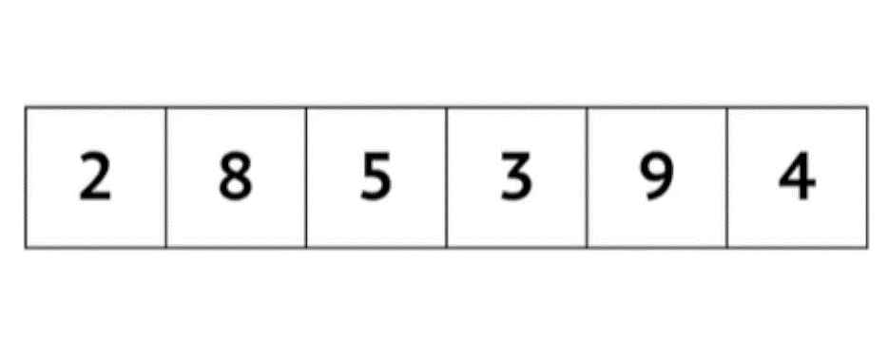
Sample 2
Insertion Sort
Insertion sort is straightforward; it picks elements and inserts them into their correct index, while pushing the rest of the elements towards right.
This way, in each iteration the left partition is always sorted and the right, unsorted side keeps shrinking until no more items are left in it.
The simulation shows sort operation using Insertion sort algorithm.
Notes:
Recall the array INSERT operation.
Animation credit: Michael Sambol.

Slide 13
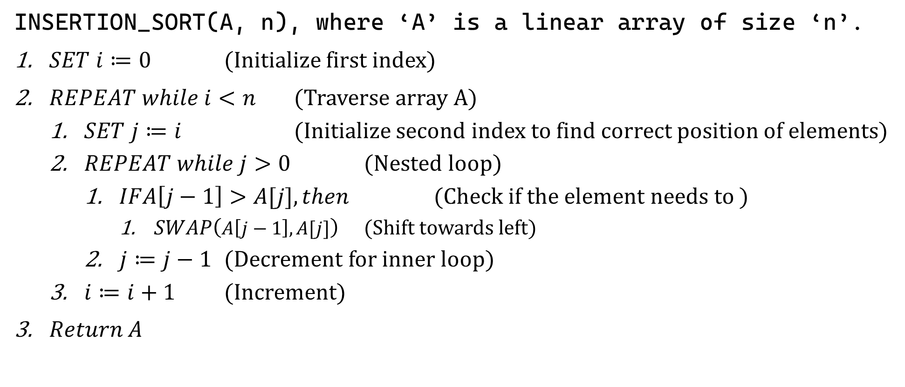
Sample 2
Insertion Sort
INSERTION_SORT(A, n), where ‘A’ is a linear array of size ‘n’.
$SET i≔0$ (Initialize first index)
$REPEAT while i<n$ (Traverse array A)
$SET j≔i$ (Initialize second index to find correct position of elements)
$REPEAT while j>0$ (Nested loop)
$IFA\left[j−1\right]>A[j], then$ (Check if the element needs to )
$SWAP\left(A\left[j−1\right],A[j]\right)$ (Shift towards left)
$j≔j−1$ (Decrement for inner loop)
$i≔i+1$ (Increment)
$Return A$

Slide 14
Sample 2
In a nut-shell
Create groups of 5 students each.
Create an unsorted array with your SIDs.
Following the Selection sort algorithm, show how your array will be sorted step-by-step.
Assuming each statement took 3ms to run, calculate the total time it took for your array to be finally sorted.

Slide 15



THANK YOU
Owais Hussain
+92 345-3174270
owais.hussain@kiet.edu.pk
https://www.researchgate.net/profile/Owais-Hussain-3

